Slide 1
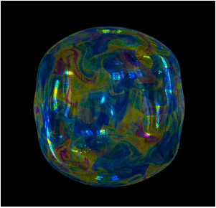
Thin-Film Smoothed Particle Hydrodynamics Fluid
Zhiqi Li, Suyang Yang, Kangjie Zhang

Slide 2
Theme
Thin-Film Bubbles
SPH method
Surface Tension
Macroscopic level
Varying thickness
Microscopic scale
Elegant, minimal-surface geometries by tension resulted from external force
Vibrant and delecate color pattern from the interference of light and varying thickness
Why SPH?
the compressible nature of SPH is helpful in our application to co-evolve
the thickness
calculate the surface tension
enforce the fluid incompressibility

Slide 3
Structure
Particle Set
Marketing Manager
Felix Henderson
Project Manager
Isabel Garcia
Copywriter
Natasha Jones
Human Resources
Kiana Anderson
Office Manager
Tyler Stein
Intern
Jordan Mitchell
Junior Designer

Slide 4

Mission statement
At Contoso, we empower organizations to foster collaborative thinking to drive workplace innovation. We believe that a company should act as a community and use tools to communicate quickly and efficiently.

Slide 5
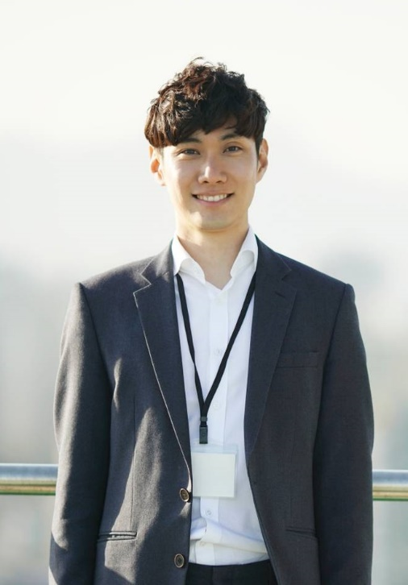



Management team
Takuma Hayashi
Mirjam Nilsson
Flora Berggren
Rajesh Santoshi
President
Chief Executive Officer
Chief Operations Officer
VP Marketing

Slide 6
The team
Taylor Philips
Marketing Manager
Felix Henderson
Project Manager
Isabel Garcia
Copywriter
Natasha Jones
Human Resources
Kiana Anderson
Office Manager
Tyler Stein
Intern
Jordan Mitchell
Junior Designer

Slide 7



Market summary
Remote work is more popular than ever, and companies are thinking about tools that create effective communication across teams.
Market trends will continue rising based on projections, which provides an opportunity for greater business reach in the region.
Our product cost is low, which gives us a market advantage.

Slide 8
Opportunities
Market gap
Costs
Few, if any, products on the market help customers like we do
Loss of productivity costing consumers thousands of dollars
Customers
Usability
66% of US consumers spend money on multiple products that only partially resolves their issue
Customers want something that is easy to use
Financials
Millennials account for about a quarter of the $48 billion spent on other products in 2018

Slide 9


Business overview

Slide 10

Business concept
Using our next-generation data architecture, we help organizations virtually manage agile workflows. We thrive because of our market knowledge and the great team behind our product.

Slide 11
Goals and objectives
Draft blueprints
Run focus groups
Gather feedback
Feb 20XX
May 20XX
Oct 20XX
20XX
JAN
FEB
MAR
APR
MAY
JUN
JUL
AUG
SEP
OCT
NOV
DEC
20XX
JAN
FEB
MAR
APR
MAY
JUN
JUL
AUG
SEP
OCT
NOV
DEC
Test design
Launch design
Deliver to client
Feb 20XX
July 20XX
Dec 20XX

Slide 12
Financials
Key metrics
Revenue by year
 | Clients | Orders | Gross revenue | Net revenue
20XX | 10 | 1100 | $10,000 | $7,000
20XX | 20 | 200 | $20,000 | $16,000
20XX | 30 | 300 | $30,000 | $25,000
20XX | 40 | 400 | $40,000 | $30,000

Slide 13
Financials table
 | YEAR 1 | YEAR 2 | YEAR 3 | DELTA
Income
Users | 50,000 | 400,000 | 1,600,000
Sales | 500,000 | 4,000,000 | 16,000,000
Average price per sale | 75 | 80 | 90
Revenue @ 15% | 5,625,000 | 48,000,000 | 216,000,000
Gross profit | 5,625,000 | 48,000,000 | 216,000,000
Expenses
Sales & marketing | 5,062,500 | 38,400,000 | 151,200,000 | 70%
Customer service | 1,687,500 | 9,600,000 | 21,600,000 | 10%
Product development | 562,500 | 2,400,000 | 10,800,000 | 5%
Research | 281,250 | 2,400,000 | 4,320,000 | 2%
Total expenses | 7,593,750 | 52,800,000 | 187,920,000

Slide 14

Risks and rewards
Risks
Rewards
New feature updates may not be popular with customers
Lack of staffing in key roles could delay product launch
Product will have more features which may require additional learning for customers
First on the market
Good publicity for the product so far, and we can build momentum from that scenario
Product testing with high-value clients have shown no issues

Slide 15

Key issues
Near term
Long term
Need funding in key roles
Lack of staffing will cause product delay
Need larger office space
Additional employees will require on-site office workspace

Slide 16
Thank you
Mirjam Nilsson​
206-555-0146
mirjam@contoso.com
www.contoso.com

